Slide 1
B2B MANAGEMENT
SUDHARSAN SRINIVASAN (1001755919)

Slide 2

What is B2B?
B2B stands for Business to Business.
Includes SaaS products, B2B Marketing firms and overall business supply chain companies.

Slide 3
Understanding B2B
B2B companies support other B2B companies.
Connects employees from different organizations.
Runs in contrast with B2C and C2B models.
Rise of Online E-Commerce startups.

Slide 4
B2B vs B2C vs C2B vs C2C
The different models of business acts differently.
B2C - Business to Customer
C2B - Consumer to Business
C2C - Consumer to Consumer
B2B - Business to Business - Sells products and services to other companies.

Slide 5
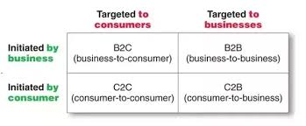
B2B vs B2C vs C2B vs C2C

Slide 6
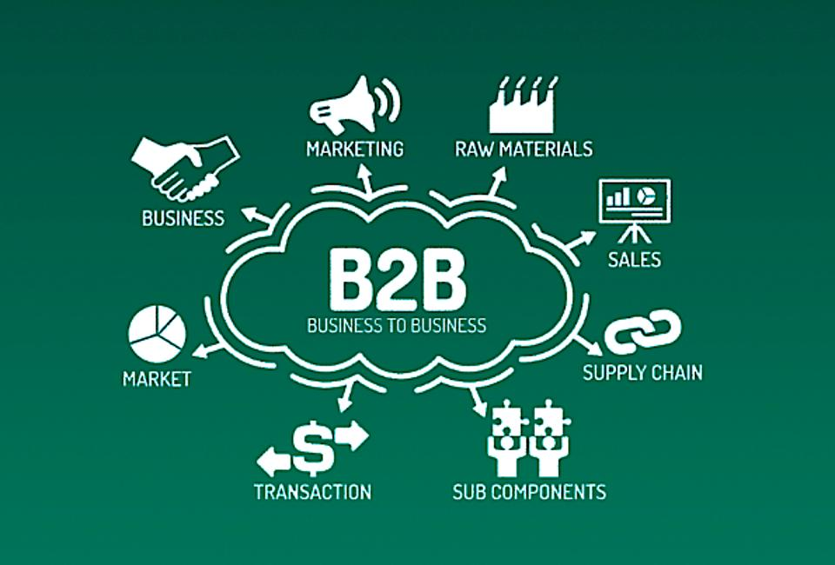
WORKING OF B2B

Slide 7
WORKING OF B2B
Transaction of goods and services.
Conduct adequate market research to find potential buyer.
Quality content.
Accurate decision making.

Slide 8
CATEGORIES OF B2B WEBSITES
Company Websites
Product Supply and procurement exchanges
Brokering sites
Information Sites

Slide 9
EXAMPLES OF B2B COMPANIES
SalesForce
LinkedIn
FedEx
Slack
AWS
J.P. Morgan

Slide 10
USAGE OF B2B
Wide variety of industrial applications of B2B
Technology
Manufacturing
Construction
Insurance
HealthCare
Education
Real estate
Food and Beverages

Slide 11

DEVELOPING A MARKET PLAN
Research and connect with prospects.
Explaining the prospects about the benefits involved.
Business specific strategy to turn potential customers into buyers.
Focus more on business growth.

Slide 12
ADVANTAGES OF B2B
Convenience - sale through storefronts.
Online transaction enabling bulk orders.
Higher profit.
Large orders - Higher potentail sales and more fund inflow for sellers.
Ease of advertising.

Slide 13
DISADVANTAGES OF B2B
More complex setup process.
Need for B2B sellers to stand out.
Need to have easy interface for users.
Longer Decision Time and Sales Process.

Slide 14

CHALLENGES IN B2B
Biggest challenge - convincing other companies
Educating potential customers incase of Digital marketing.
Focus on building relationships with other company's decision makers.

Slide 15
THINGS TO CONSIDER FOR B2B
Some points to consider:
Well- trained and knowledgeable sales team.
Keep in mind the tone while speaking to other companies.
Emphasis on building relationships.
Explaining the ROI from your product.

Slide 16

RECENT TRENDS
Moving away from Theme Sites.
Meaningful data and metrics.
Quality in Content Marketing.
Focus on the prospect.

Slide 17
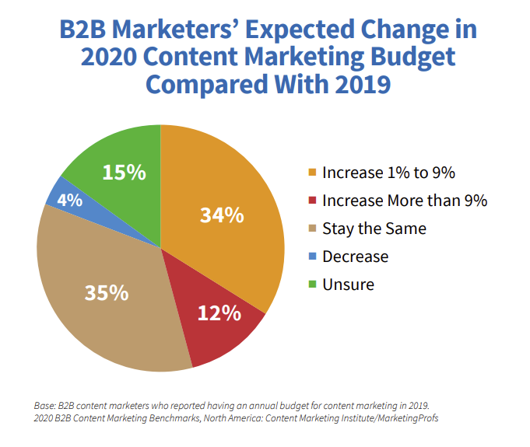
FINAL THOUGHTS
Deep knowledge of emerging landscape of B2B.
Investing in new skills.
Smarter, more targeted advertising.
Optimized websites to attract customer interests.

Slide 18
REFERENCES
www.businessnewsdaily.com/5000-what-is-b2b.html
searchcio.techtarget.com/definition/B2B
www.disruptiveadvertising.com/business/b2b-companies/
bizfluent.com/info-7754273-advantages-disadvantages-b2b.html
altitudemarketing.com/blog/2020-b2b-marketing-trends/
www.investopedia.com/terms/b/btob.asp

Slide 19

THANK YOU

